Slide 1
CODATA-RDA Schools
FAIRSFAIR Kick Off Meeting
Amsterdam
March 15 2019
Hugh.Shanahan@rhul.ac.uk
https://hughshanahan.github.io/KickoffTalk

Slide 2
Competency centres
Provide materials
Get feedback from ESFRI’s
Conduit for reaching out to ESFRI’s for related schools
Trial and implement training through short courses
Modelled on successful CODATA-RDA School of Research Data Science
Scale through train-the-trainer activity

Slide 3
CODATA-RDA schools
Two week event
Focus on ECR’s from LMIC’s
Data Science skills
NOT another bootcamp!
6 Schools since 2016
Run on three continents
~250 students from 40 countries

Slide 4
DSDENG
DSDENG
Curriculum
Software Carpentry
Computational Infrastructures
DSDA
Visualisation
DSDM, DSRM
Open Science
DSDM
DSDA
Research Data Management
Machine Learning
DSDM
DSDENG
Author Carpentry
Information Security
DSDA, DSDM, DSRM, DSDENG - EDISON Competence groups

Slide 5
Pilot version (Trieste August 2019)
Data Science
Strand
Common
Data Steward
Strand
Week 1
Week 2

Slide 6


Full version - Q1 2020
Data Science
Strand
Additional
Data
Search
Data
From
Analysis
Meta-
Analysis
Common
Initial Data Set
Annotation
Data Steward
Strand
Week 1
Week 2
Speaking with other professional groups - DigCurv

Slide 7
Train trainers
Need to learn from others
Training in CODATA-RDA is based on shadowing
First approach - run TT in parallel with schools
Open to different approaches here

Slide 8
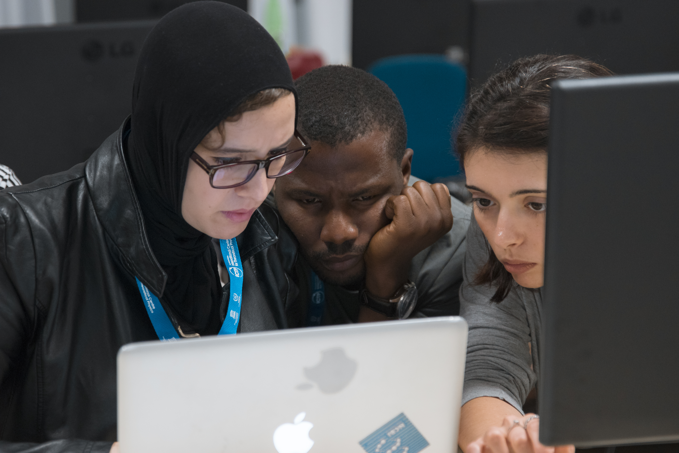
Remember
Most of all what’re doing here is
Changing a culture
Getting people to work together
Building communities that
follow an approach
That is really, really, hard.

Slide 9
Questions
Is the simulated model for week 2 reasonable?
Are there better concepts for Train Trainers?

